Slide 1
Ripple I and II: Communicating through Physical Vibrations
Roy et. al., UIUC, NSDI 2015 and NSDI 2016
Reading Group Presentation
by Swadhin Pradhan
03/23/2016
Notes:
Hi, this is Swadhin, today I am going to present our paper “Ripple: Communicating through physical vibrations”.

Slide 2
RIPPLE - I
~200 bps
Notes:
<CLICK> Every mobile phone has with a tiny device called the vibration motor...which is responsible to generate the vibration-alert.
<CLICK> Smartphones also have a sensor called accelerometer that measures the motion of the phone

Slide 3

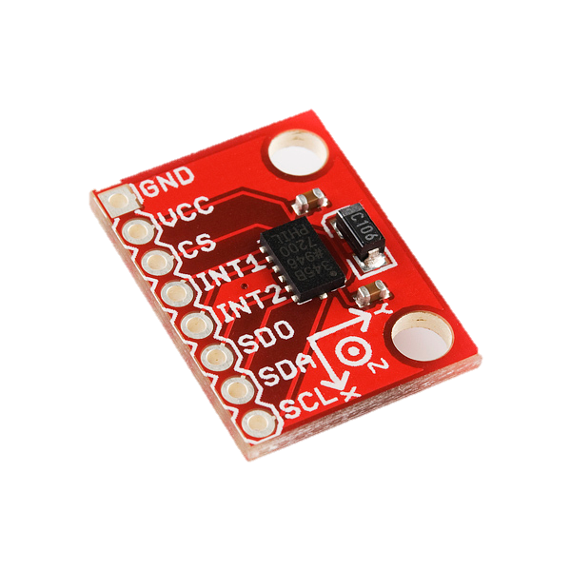
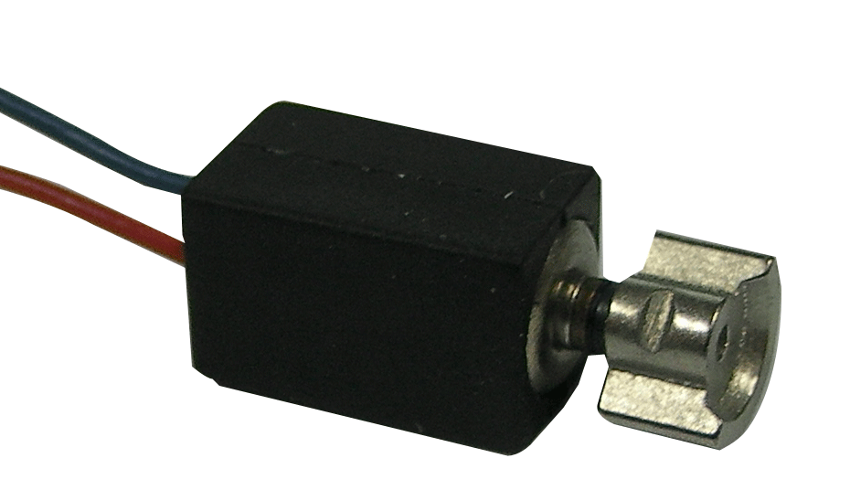
Accelerometer
Vibration Motor
Notes:
<CLICK> Every mobile phone has with a tiny device called the vibration motor...which is responsible to generate the vibration-alert.
<CLICK> Smartphones also have a sensor called accelerometer that measures the motion of the phone

Slide 4
Accelerometer
Vibration Motor
Notes:
So, one phone can essentially touch another phone and transmit bits of information as the patterns of vibration and the other phone can sense the motion and recover the data.

Slide 5
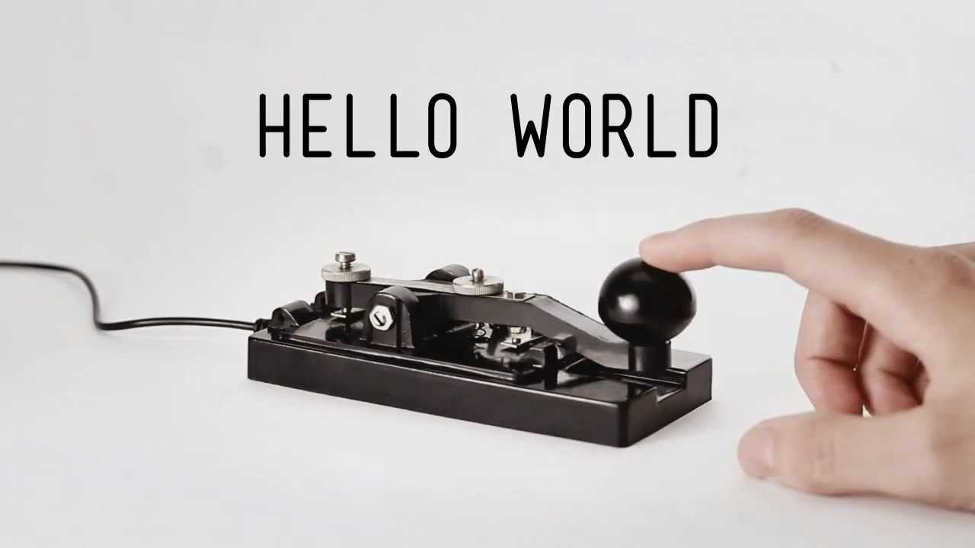
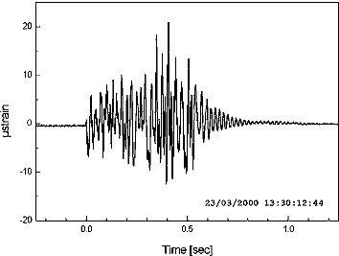
Morse Code Key
On
On
On
Off
Modulated vibration
Accelerometer
Vibration Motor
Notes:
Here the simple way to communicate may be <CLICK> the Morse-code like pattern by turning the motor on and off.
However, in this paper, we are breaking away from this approach, and trying to develop techniques to <CLICK> modulate the individual vibration frequencies, which can offer significantly higher datarate than the on-off like pattern can ever achieve. With this promise <NEXT>

Slide 6
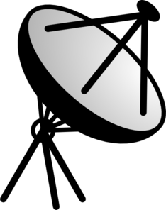
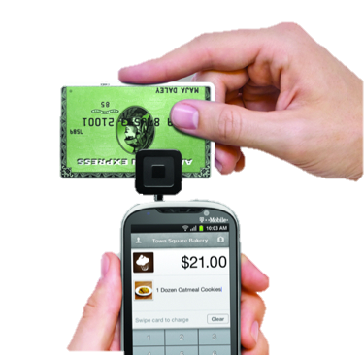

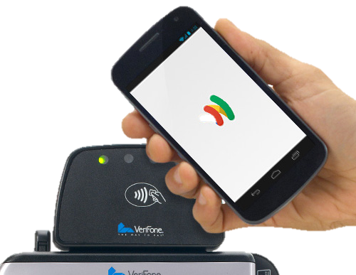
Applications: Mobile Money Transfer
Notes:
One possible application…is mobile money transfer. ‘Apple’ has been doing it with NFC, Square has been doing it with a special piece of hardware. But in recent times there have been several attacks launched which essentially overhear the wireless broadcast of the NFC. And in square case the extra hardware is needed.

Slide 7

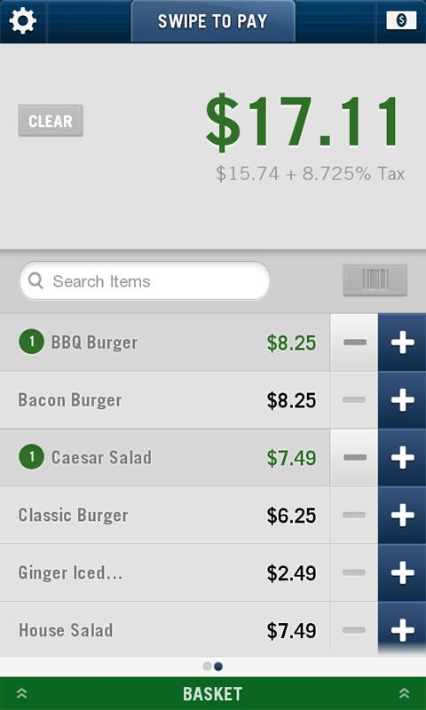
Applications: Mobile Money Transfer
SEND
RECEIVE
Notes:
We are hoping that with out project Ripple.. two phones would be able to touch each other to exchange credit card information or in general any information they might want to share.

Slide 8
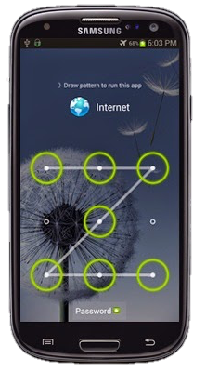
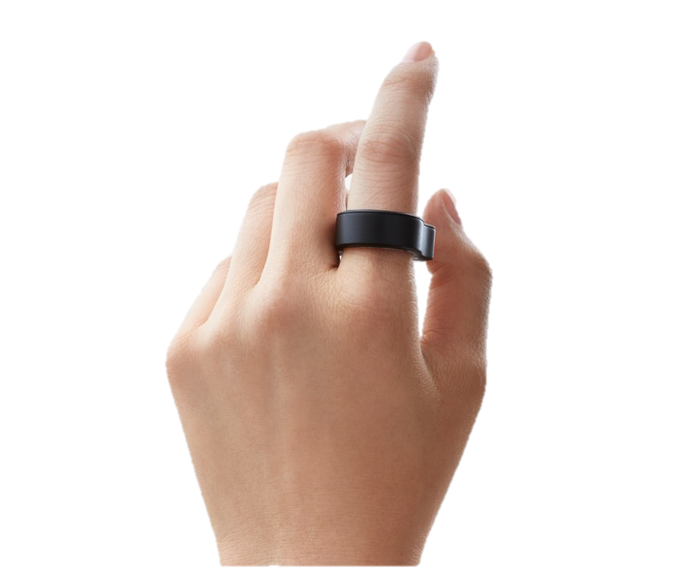
Applications: Authentication with Ring
Vibratory
Passcode Detected
Notes:
She could simply touch the phone and the password could be transmitted through bone conduction.

Slide 9
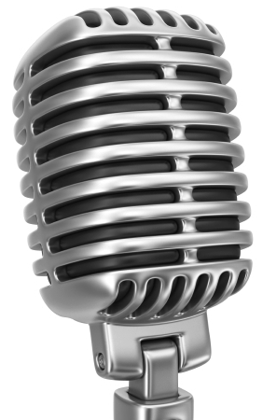
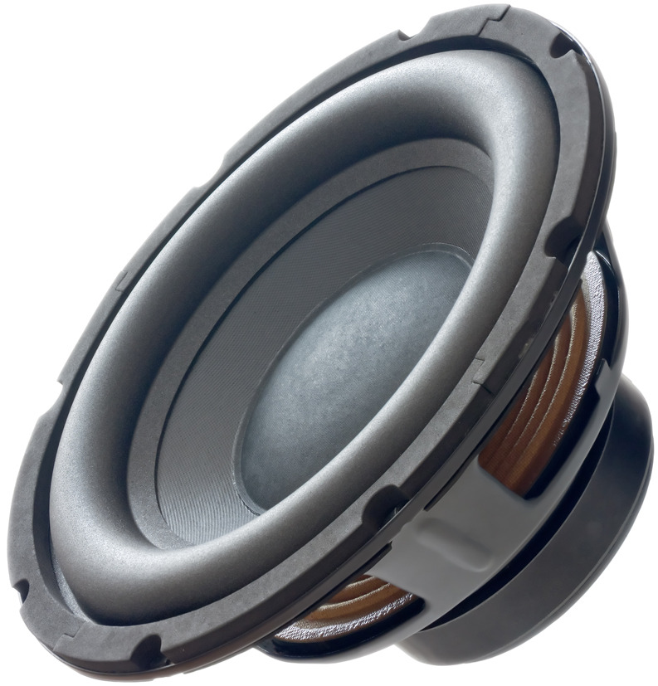
Application
6 bps 80 bps 200 bps 400 bps +secured
Vibratory Radio
Morse-code
Single-Carrier
Multi-Carrier
Multi-dimension
Phy-Security
Hardware
Notes:
However, we are hoping to do the research bottom up…<CLICK>and we are trying to develop a vibratory radio on the top of the hardware like accelerometer, vibration motor et cetera…
We believe, once the techniques are available with sufficient datarate…applications will emerge over time.
<CLICK>This talk is about the techniques that we have used to take the system from a few bits per second to the 400 bits per second, a more secure system.

Slide 10
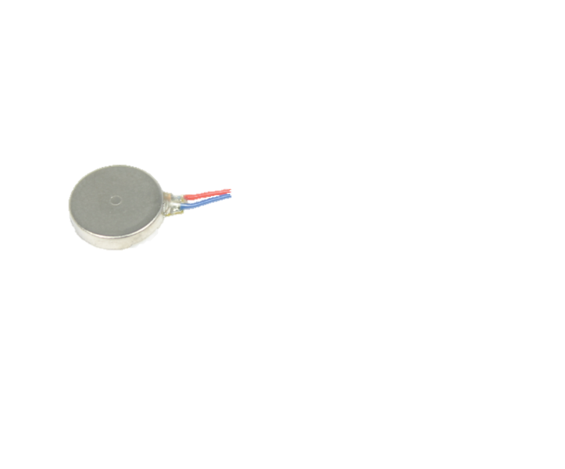
Morse-code
Single-Carrier
Multi-Carrier
Multi-dimension
Phy-Security
Vibration Motor
Accelerometer
C1
C2
N
S
Notes:
Lets start with an overview of the vibration motor and the accelerometer.
<CLICK> The vibration motor has a magnetic mass placed near a coil. When we apply voltage to the coil it creates the electromotive force that makes the mass to… <CLICK> … oscillate. This motion creates the vibration.
<CLICK> The accelerometer also has a movable structure that responds to the vibration and converts the vibration to the electrical signal.

Slide 11

Morse-code
Single-Carrier
Multi-Carrier
Multi-dimension
Phy-Security
0
30
60
90
120 ms
Regulated
Input
Vibration
Braking
Notes:
While we randomly turn on and off the vibration motor we get a pulse, which is basically a combination of various uncontrolled frequencies with different rise and decay rate. The long tail actually limits the shortest possible pulse length and thereby limits the datarate to around 6 bits per second.
<CLICK>So, first… we regulate the input signal of the motor to generate vibration of a single frequency. However, the due to the inertial motion of the magnetic mass of the motor, the system behaves as a damped second order system and we still get <CLICK> a decaying tail in the received pulse.
<CLICK>We used a technique called vibration braking to reduce this tail. While the details is in the paper, we basically exploited the reverse electromotive force of the motor to prematurely stop the natural movement of the mass.

Slide 12
Morse-code
Single-Carrier
Multi-Carrier
Multi-dimension
Phy-Security
0
30
60
90
120 ms
Notes:
With shorter pulse of a single frequency, now we can apply amplitude modulation to encode bits of information.

Slide 13
Morse-code
Single-Carrier
Multi-Carrier
Multi-dimension
Phy-Security
Single-Carrier
Multi-Carrier
Notes:
Looking for opportunities, now we moved to the multi-carrier system.

Slide 14
Morse-code
Single-Carrier
Multi-Carrier
Multi-dimension
Phy-Security
0
30
60
90
120 ms
100 Hz
200 Hz
300 Hz
Notes:
It is just multiple single carriers with different frequencies, modulated with different data and <CLICK>transmitted simultaneously<CLICK>

Slide 15
Morse-code
Single-Carrier
Multi-Carrier
Multi-dimension
Phy-Security
+
…
+
N
S
Notes:
Now when we transmit 10 such channels together, the system completely fails. We could not recover any data. And the reason is…the vibrator motor does not behave equally for all frequencies.

Slide 16
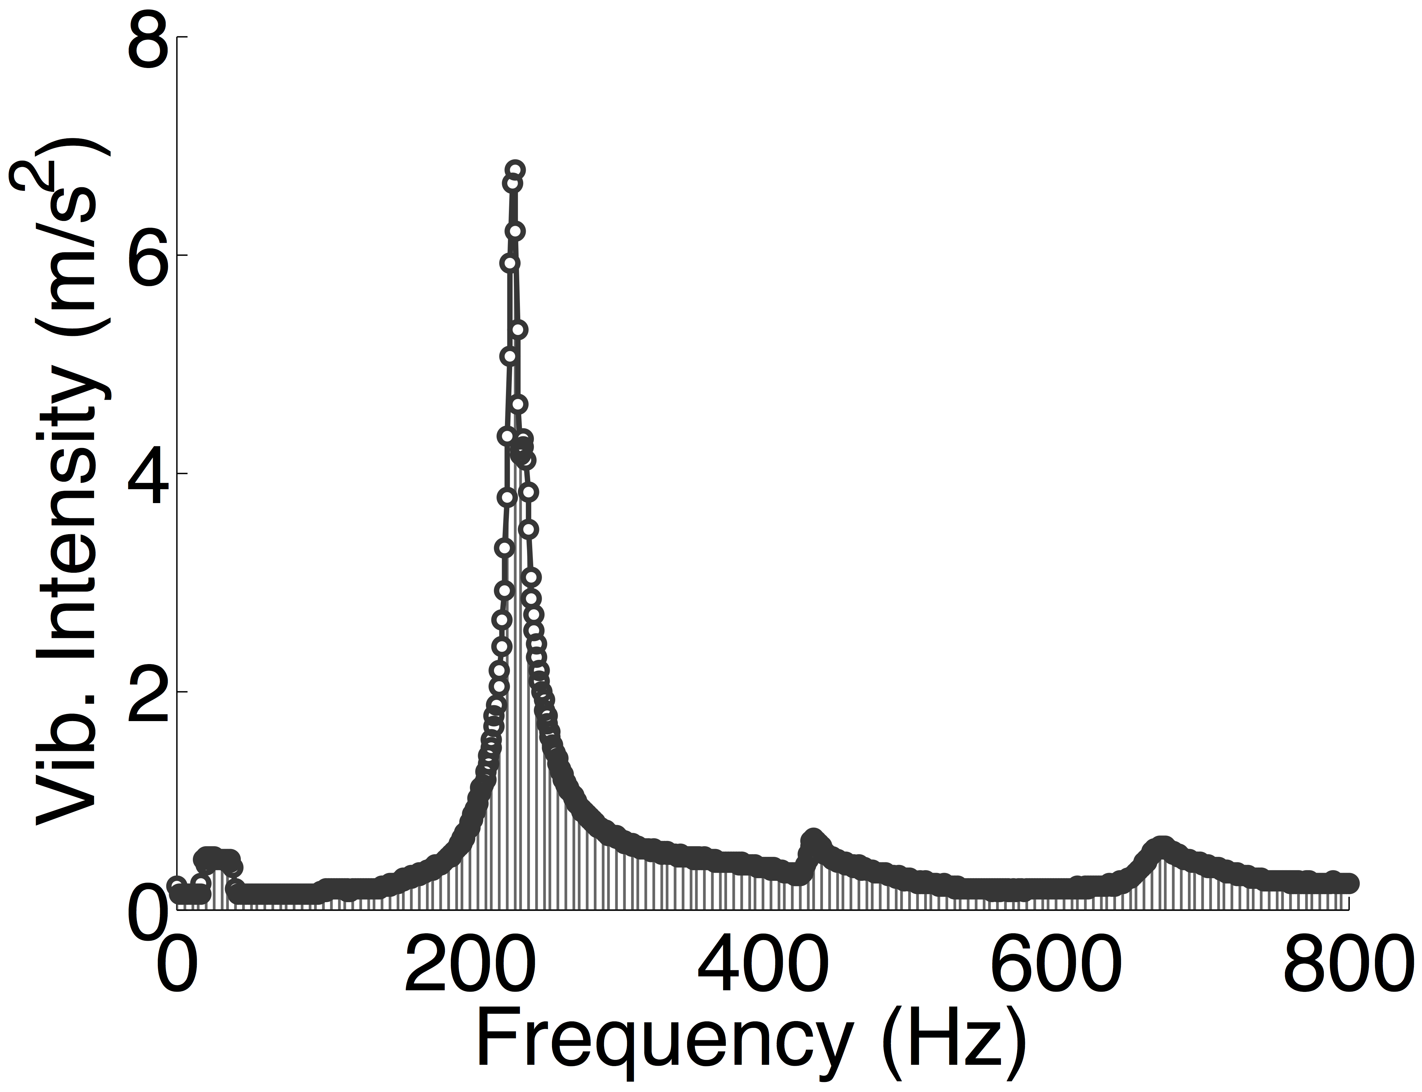
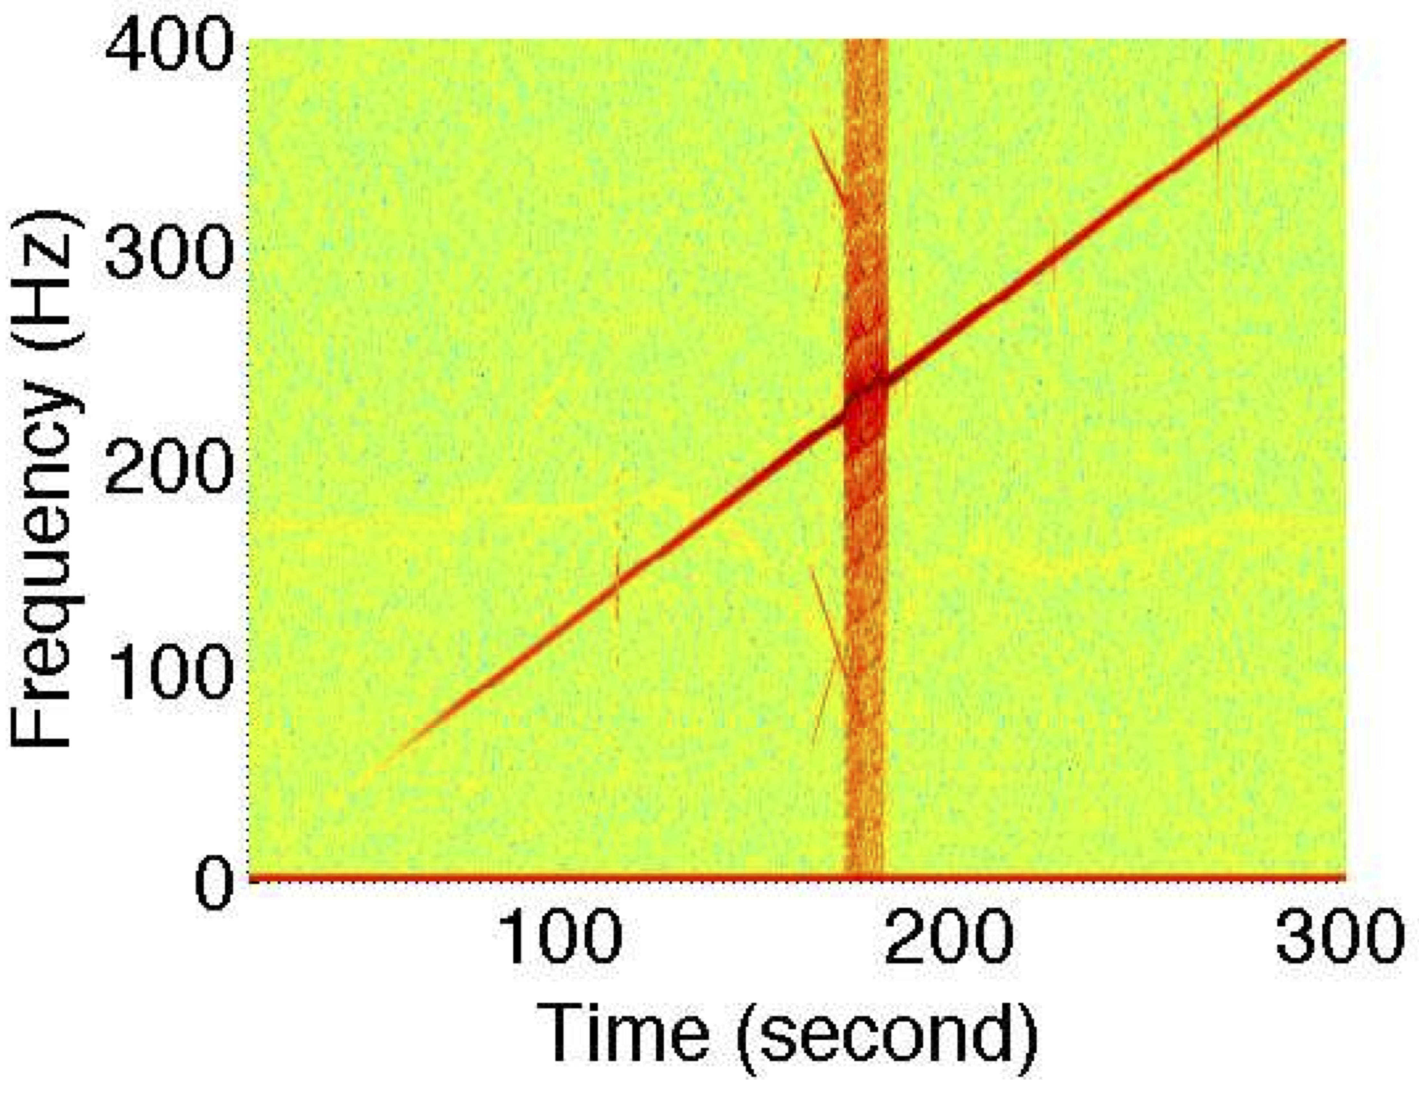
Morse-code
Single-Carrier
Multi-Carrier
Multi-dimension
Phy-Security
Resonance frequency removal
Notes:
The frequency response shows that the vibrator motor gives extremely high gain for <CLICK> a band of frequency, which is called resonance band. Apparently, high gain should be good for the transmission.
<CLICK> BUT the frequency domain plot indicates that when we drive the vibration motor with resonance frequency it becomes non-linear and <CLICK> spills energy on all over the spectrum. It basically ruins the opportunity to transmit data in parallel channels.

Slide 17
Morse-code
Single-Carrier
Multi-Carrier
Multi-dimension
Phy-Security
Resonance frequency removal
Notes:
As a simple solution, we avoided the the resonance band while selecting carriers for the multi-carrier system.

Slide 18
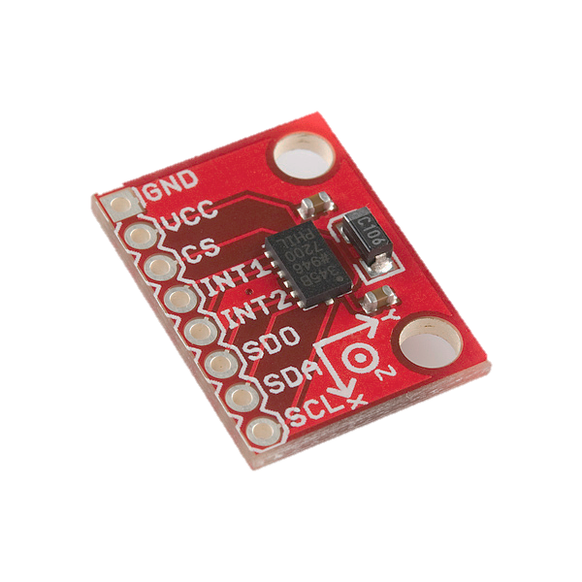
Morse-code
Single-Carrier
Multi-Carrier
Multi-dimension
Phy-Security
Z
Y
X
Notes:
Therefore, probably we can transmit 3 datastreams simultaneously.

Slide 19
Morse-code
Single-Carrier
Multi-Carrier
Multi-dimension
Phy-Security
Z
Y
X
Notes:
However, when we apply vibration along an axis <NEXT>

Slide 20
Morse-code
Single-Carrier
Multi-Carrier
Multi-dimension
Phy-Security
Z
Y
Spilled signal
X
Notes:
It partially appears on the other axes and interferes with the signal that we might want to transmit on that axis.

Slide 21
Morse-code
Single-Carrier
Multi-Carrier
Multi-dimension
Phy-Security
Z
Y
Phase lag
Spilled signal
X
Spilled Noise removal
Notes:
We observed that this spilled signal has 180 degree phase lag with the actual signal. In the next example we will explain how we can exploit this phenomena to remove the interference.

Slide 22
Morse-code
Single-Carrier
Multi-Carrier
Multi-dimension
Phy-Security
Y signal
2h
Y-Axis
Z-Axis
Spilled Noise removal
Notes:
Say we apply a signal on Y axis, <NEXT>

Slide 23
Morse-code
Single-Carrier
Multi-Carrier
Multi-dimension
Phy-Security
Y signal
2h
Y-Axis
h
Z-Axis
Y spill
Spilled Noise removal
Notes:
And get the spill on the other axis, with the phase difference.

Slide 24
Morse-code
Single-Carrier
Multi-Carrier
Multi-dimension
Phy-Security
Y signal
2h
h
Z spill
Y-Axis
Z signal
2h
h
Z-Axis
Y spill
Spilled Noise removal
Notes:
Similarly applying some other the signal on the z-axis will create the spill on the Y-axis.

Slide 25
Morse-code
Single-Carrier
Multi-Carrier
Multi-dimension
Phy-Security
Y signal
Scaled Y signal
2h
h
2
=
4h
2h
*
Z spill
Y-Axis
Z signal
2h
h
Z-Axis
Y spill
Spilled Noise removal
Notes:
Now, before decoding, we scale-up the Y-axis signal so that

Slide 26
Morse-code
Single-Carrier
Multi-Carrier
Multi-dimension
Phy-Security
Y signal
Scaled Y signal
2h
h
2
=
4h
2h
*
Z spill
Y-Axis
Z signal
2h
h
Z-Axis
Y spill
Spilled Noise removal
Notes:
The amplitude of the interfering signal exactly matches with the …

Slide 27
Morse-code
Single-Carrier
Multi-Carrier
Multi-dimension
Phy-Security
Y signal
Scaled Y signal
2h
h
2
=
4h
2h
*
Z spill
Y-Axis
Z signal
2h
h
Z-Axis
Y spill
Spilled Noise removal
Notes:
Actual signal on Z-axis.

Slide 28
Morse-code
Single-Carrier
Multi-Carrier
Multi-dimension
Phy-Security
Y signal
Scaled Y signal
2h
h
2
=
4h
2h
*
Z spill
Y-Axis
Z signal
2h
h
+
Z-Axis
Y spill
Spilled Noise removal
Notes:
Then we simply add them together.

Slide 29
Morse-code
Single-Carrier
Multi-Carrier
Multi-dimension
Phy-Security
Y signal
Scaled Y signal
2h
h
2
=
4h
2h
*
Z spill
Y-Axis
Interference free Y signal
Z signal
=
3h
2h
h
+
Z-Axis
Y spill
Spilled Noise removal
Notes:
It removes the interference on the Y-axis signal.
Once we recover the signal on Y-axis we can remove it from the combination to recover the other signal.

Slide 30
Morse-code
Single-Carrier
Multi-Carrier
Multi-dimension
Phy-Security
Physical Layer Security
Notes:
As the vibration does not broadcast signal in the air, security might be an application area for Ripple. However, there are some side channels

Slide 31

Morse-code
Single-Carrier
Multi-Carrier
Multi-dimension
Phy-Security
N
S
1 0 1
Correlated
Notes:
Along with the vibration, the moving mass of the motor generates<CLICK> sound while vibrating at a very high speed. And this sound <CLICK>
…is correlated with the data it transmit. Therefore, even if the vibratory signal is not accessible, an attacker can listen to this sound of vibration and decode the data.
One obvious solution is to use jamming signal. Lets see how it works.

Slide 32


Morse-code
Single-Carrier
Multi-Carrier
Multi-dimension
Phy-Security
Vibration sound
Speaker sound
Jamming for Security
Notes:
<CLICK> When device transmits data it generates vibration sound.
<CLICK> a built-in, co-located speaker can simultaneously generate a jamming sound.
<CLICK> The combination makes it difficult for the attacker to recover the data.

Slide 33
Morse-code
Single-Carrier
Multi-Carrier
Multi-dimension
Phy-Security
Vibration sound
Speaker sound
Jamming for Security
Notes:
However, for various reasons jamming is not the ideal solution. Instead we attempt to cancel the sound of vibration by generating anti-sound through the speaker.
<CLICK> The anti sound is actually the same waveform as the vibration sound, but..
<CLICK> reverse in amplitude.
<CLICK> When this two waveforms combine, they completely cancel each other.

Slide 34
Morse-code
Single-Carrier
Multi-Carrier
Multi-dimension
Phy-Security
Vibration sound
Speaker sound
Jamming for Security (Phase Mismatch)
Notes:
Is to exactly match the phases of these two sounds.
<CLICK> If the there is any phase mismatch
<CLICK> we can end up amplifying the sound, instead of cancelling this. To perform this phase alignment we need a real-time control over the audio processing system. Unfortunately, none of the mobile devices offers such control.

Slide 35
Morse-code
Single-Carrier
Multi-Carrier
Multi-dimension
Phy-Security
Vibration sound
Speaker sound
Jamming for Security (Phase Mismatch)
Notes:
Going back to the same setting, the vibration sound is in the air…we have to play the anti-sound. But instead of playing it with the correct frequency..we first increase the frequency a little <CLICK>.
<CLICK>Now when these two waveforms combine, they don’t cancel rather <CLICK> shows periodic cancellation and amplification.
<CLICK> and we get a wavy envelope of the signal.

Slide 36
Morse-code
Single-Carrier
Multi-Carrier
Multi-dimension
Phy-Security
Vibration sound
Speaker sound
Notes:
The device listened to this waveform and <CLICK> follows the envelope. When the envelope comes to a minimum we know that the phase of the sounds are at match…then we change the frequency back to actual value…<CLICK> It locks the phase difference and we get constant destruction after that.

Slide 37
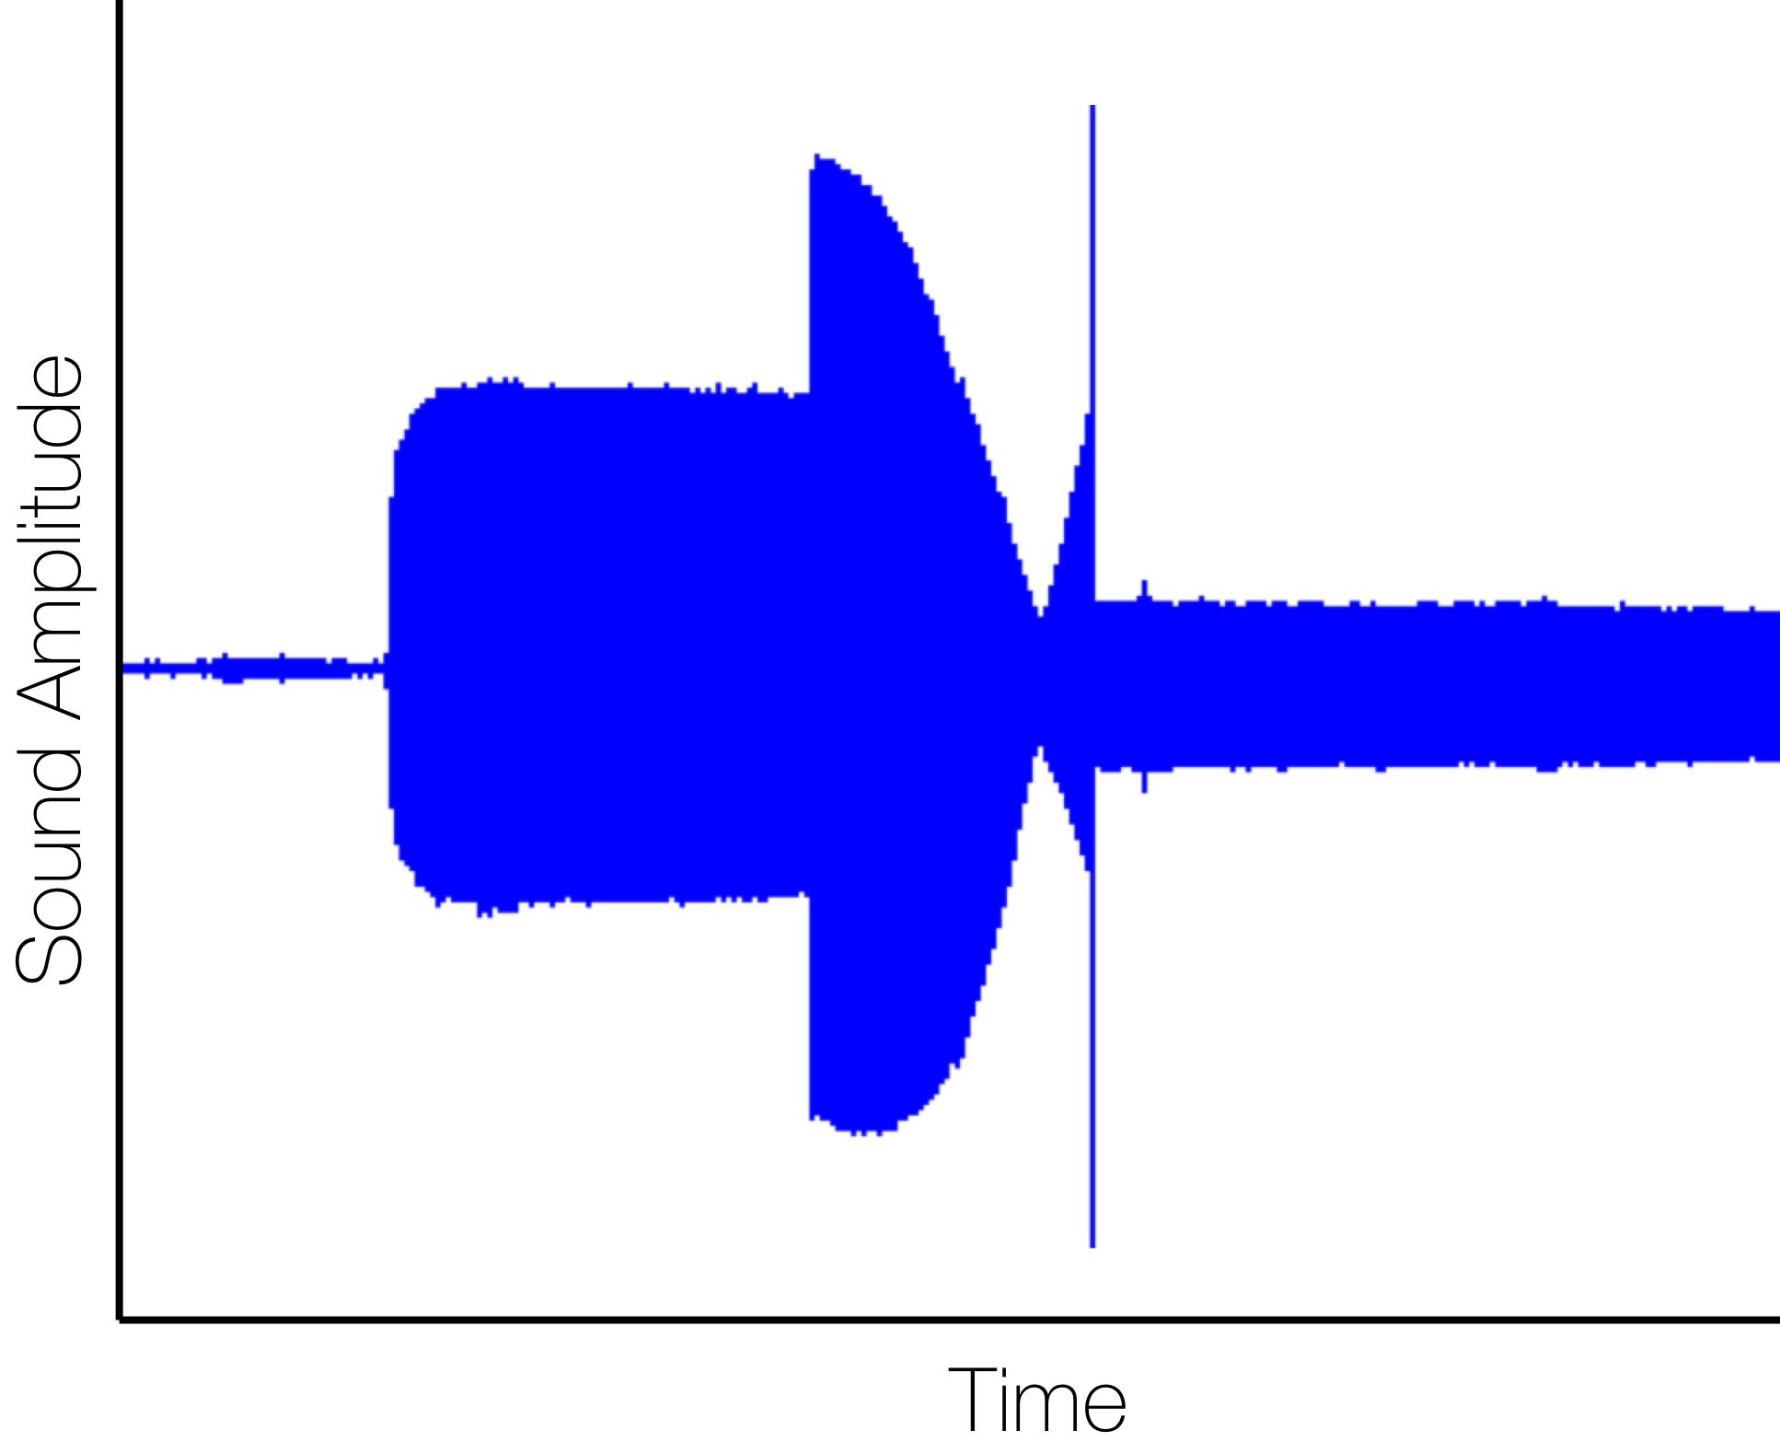
Morse-code
Single-Carrier
Multi-Carrier
Multi-dimension
Phy-Security
Anti-sound start
Frequency switch
Vibration start
Notes:
This plot shows how this technique works in reality.
At this point the vibration starts and after some time we start the anti-sound with increased frequency. We can see the varying envelope. When it observes a minimum value, it switches the frequency and we have a constant reduction in sound after that point.
However, as the system could not identify the minimum value of the envelope, it leaves some residual sound, which we can camouflage with a faint jamming signal.

Slide 38
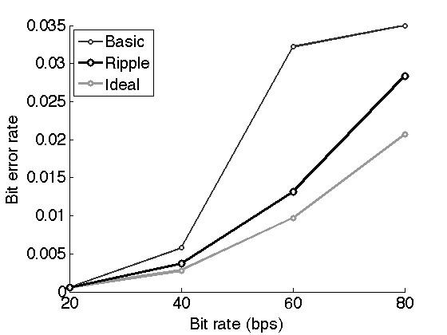
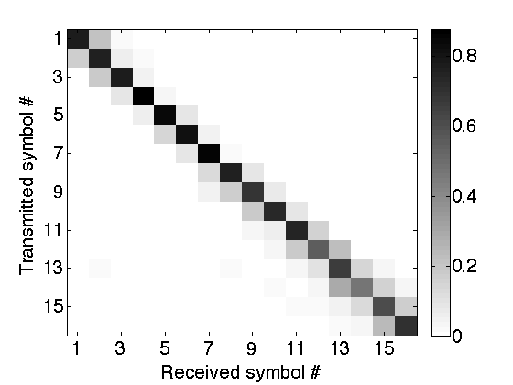
Evaluation
Single-carrier
Notes:
In the evaluation, the single carrier system shows around 3% error-rate at highest speed. In the heatmap of the transmitted and received symbol, we can see that most of the errors are adjacent to the actual symbol, which indicates that appropriate coding can improve the performance.

Slide 39
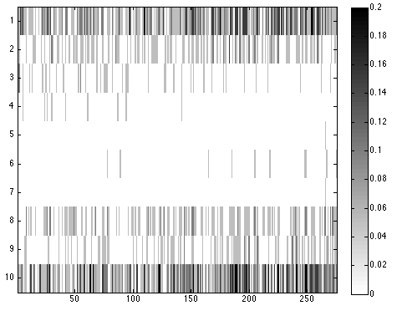
Evaluation
Multi-carrier
Notes:
This plot shows the distribution of bit error in multicarrier system for different signal energy. At the highest SNR Ripple achieves the 80th percentile error-rate of around 2 percent. However, as we can see in the other plot, some carriers performs extremely well compared to the other. Careful selection of carriers can improve the performance.

Slide 40
RIPPLE - II
~30 kbps
Notes:
<CLICK> Every mobile phone has with a tiny device called the vibration motor...which is responsible to generate the vibration-alert.
<CLICK> Smartphones also have a sensor called accelerometer that measures the motion of the phone

Slide 41
Search for a better Ripple
0.2K
Ripple - I
0.3K
Ultrasound
1.0K
Visible Light
9.6K
Infrared
Ripple - II
32K
NFC
106K
(bits-per-second, entry level versions)
Notes:
<CLICK> Every mobile phone has with a tiny device called the vibration motor...which is responsible to generate the vibration-alert.
<CLICK> Smartphones also have a sensor called accelerometer that measures the motion of the phone

Slide 42
Hardware Front-end

Slide 43
A better sensor for physical vibration
The receiver:
Accelerometer
Vibration
Notes:
On the receiver side,
The traditional vibration sensor is the accelerometer, it is a micro-electromechanical device with a movable structure that responds to the ambient vibration.
This is sensor is suitable for movement detection and gesture recognition. However, when we try to use it as a communication receiver, which has a strict requirement of bandwidth, phase information, noise floor, accelerometer falls short.
While searching for a more appropriate sensor for vibration detection…

Slide 44
A better sensor for physical vibration
The receiver:
Accelerometer
Vibration
Microphone
+
-
Vibration
+ Sound
Notes:
We found microphone satisfies most of these requirements. Essentially microphone working principle also depends on the mechanical movement of its diaphragm which responds mainly to the air-borne sound waves. We observed that the physical vibration also influences its movement and hence it can be used as the vibration sensor.
In fact a better one..

Slide 45
A better sensor for physical vibration
The receiver:
Accelerometer
Amplitude
Vibration
Frequency
1K
5K
10K
15K
Microphone
+
Amplitude
-
Vibration
+ Sound
Frequency
1K
5K
10K
15K
Notes:
because of its wide bandwidth.

Slide 46
A better sensor for physical vibration
The receiver:
Accelerometer
Amplitude
Vibration
Frequency
1K
5K
10K
15K
OFDM
Microphone
+
Amplitude
-
Vibration
+ Sound
Frequency
1K
5K
10K
15K
Notes:
We can implement OFDM to optimally use this bandwidth and get higher datarate.

Slide 47
A better sensor for physical vibration
The receiver:
OFDM
But wait…
Microphone
+
Amplitude
-
Vibration
+ Sound
Frequency
1K
5K
10K
15K
Notes:
But wait…

Slide 48

A better sensor for physical vibration
The receiver:
Ambient sound
OFDM
Microphone
+
Amplitude
-
Vibration
+ Sound
Frequency
1K
5K
10K
15K
Notes:
Microphone is basically a sound sensor…it also picks up the ambient sound, which is much stronger than the vibration. We must cancel this sound somehow at the receiver before the decoding.

Slide 49
Receiver recovery

Slide 50
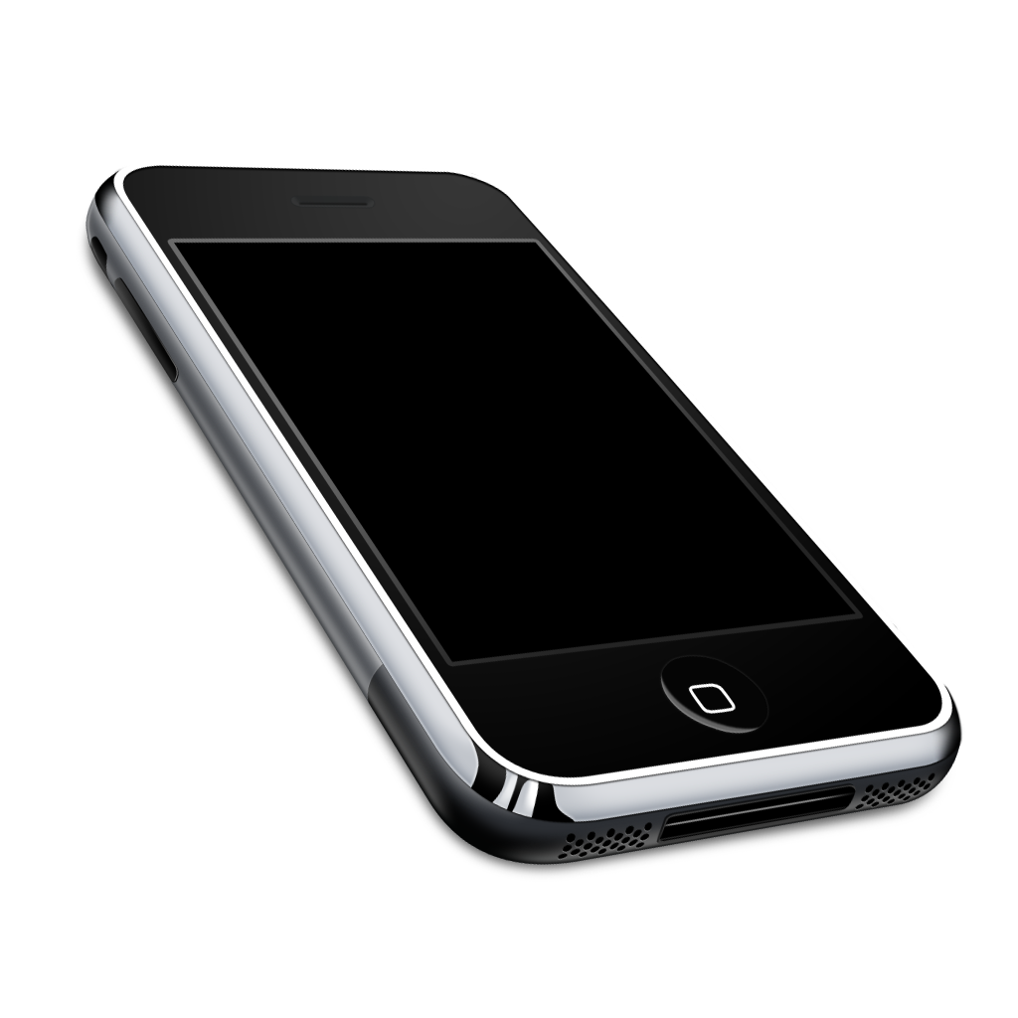

Vibration recovery at receiver
Vibration
Primary mic.
V
V
Notes:
Ideally, we expect the output signal of the microphone contains only the vibration from the Ripple transmitter. However…

Slide 51
Vibration recovery at receiver
Vibration
Primary mic.
V
V+S
S
Sound
Notes:
There are additive interferences from the sound sources. With only one microphone, it is difficult to completely recover the vibration signal from this mixture. Therefore,…

Slide 52
Vibration recovery at receiver
Vibration
Primary mic.
V
V+S
S
S
S
Sound
Secondary mic.
Notes:
we use another microphone that is exposed to the interference. And the idea is to …

Slide 53
Vibration recovery at receiver
Vibration
Primary mic.
V
V+S
-
S
V
S
S
Sound
Secondary mic.
Notes:
…subtract the intereference from the mixture to get the vibration signal back. Having two or more microphone is a pretty common design in latest smart-devices. We just leveraged this opportunity.
======
For example, Samsung galaxy S-4 has three microphone in these location. Actually, whenever a handsfree device is attached to this smartphone it activates the extra microphone to cancel the noise from voice data using a similar technique.
However, this is an oversimplification of the actual technique, becasue...

Slide 54
Vibration recovery at receiver
Vibration
Primary mic.
V
V+S
Adaptive
Filter
S
V
S”
S”
Sound
Secondary mic.
Notes:
This subtraction is generally done by a signal processing technique called adaptive filter. It requires that vibration signal and the signal on the reference microphone is uncorrelated.

Slide 55
Vibration recovery at receiver
Vibration
Primary mic.
V
V+S
Adaptive
Filter
S
V”
V
S”
V”+
S”
Sound
Secondary mic.
Notes:
Unfortunately, as both of the microphones are mounted on the same board, the vibration signal leaks through the physical contact and reaches to the second microphone. Therefore the signal no longer remains uncorrelated. And..

Slide 56
Vibration recovery at receiver
Vibration
Primary mic.
V
V+S
Adaptive
Filter
S
V”
V
S”
V”+
S”
Sound
Secondary mic.
Signal sources are correlated
Notes:
This makes the adaptive filter to remove a part of the vibration signal…leaving a distorted version which is not qualified for decoding.
We use the following technique to get over this problem.

Slide 57
Vibration recovery at receiver
Vibration
Primary mic.
V
V+S
Adaptive
Filter
Symbol Selective Adaptive Filtering
S
V”
V
S”
V”+
S”
Sound
Secondary mic.
Signal sources are correlated
Notes:
We get over this problem using our technique called symbol selective adaptive filtering. The key intuition is:

Slide 58
Vibration recovery at receiver
Noise is sparse in frequency
Ambient sound
Vibration frequency bins
Amplitude
Frequency
Notes:
The sound noise is sparse in frequency domain and if we consider only the frequency bin which are affected by the noise, the correlation property for the adaptive filter holds. But the question is how to identify those bins.

Slide 59
Vibration recovery at receiver
Noise is sparse in frequency
Static channel between the sensors
Primary mic.
Ambient sound
H
Vibration frequency bins
Amplitude
Secondary mic.
Frequency
Notes:
The fact that helps here is the channel the microphones is constant, and we can estimate this channel with the pilots.

Slide 60
Vibration recovery at receiver
Selected bins
(primary mic.)
Adaptive
Filter
Corrected bins
Selected bins
(secondary mic.)
Notes:
Once we do that we pass only those bins to the adaptive filter to correct them.
Later we combine these corrected bins with the rest of the signals and pass it to the OFDM decoder.

Slide 61
MAC Layer

Slide 62


MAC layer rate control
1
Packet 02
Packet 01
Transmitter
side
Receiver
side
Symbol 03
Symbol 07
Symbol 02
Symbol 06
Symbol 05
Symbol 04
Symbol 01
Notes:
Number one: instead of using packet level rate control…it uses sub-packet or symbol level rate control. It gives some benefit for small amount of data and a longer packet size.

Slide 63
MAC layer rate control
ACK
2
Packet 02
Packet 01
Transmitter
side
Receiver
side
Symbol 03
Symbol 07
Symbol 02
Symbol 06
Symbol 05
Symbol 04
Symbol 01
Interference
sensing
Notes:
And number two: instead of using explicit acknowledgement from the receiver, it uses transmitter side interference sensing to detect a successful delivery, which simplifies the receiver side hardware requirement. It is particularly possible because of the close proximity between the transmitter and receiver.

Slide 64
MAC layer rate control
ACK
Packet 02
Packet 01
Transmitter
side
Receiver
side
Symbol 03
Symbol 07
Symbol 02
Symbol 06
Symbol 05
Symbol 04
Symbol 01
Interference
sensing
Notes:
Now lets focus on the transmitter side interference sensing. Instead of using a separate vibration sensor at the transmitter we observed that..

Slide 65
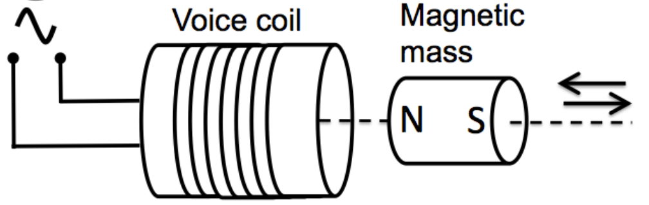
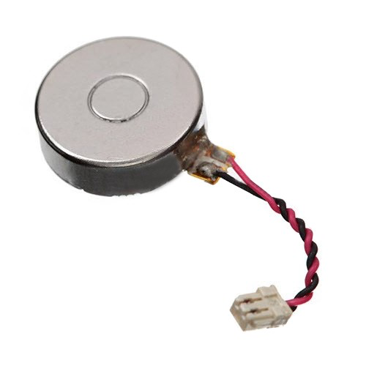
MAC layer rate control
Notes:
Recall that the vibration motor has a magnetic mass that pulsates near a coil.

Slide 66
MAC layer rate control
Notes:
Now any movement of this mass due to the ambient sound or vibration manifests as…

Slide 67
MAC layer rate control
Back-EMF
Notes:
A reverse electromotive force called Back-EMF.

Slide 68
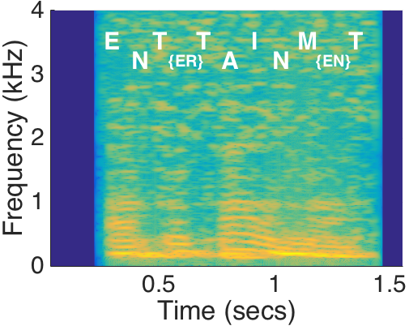
MAC layer rate control
Back-EMF
Notes:
If we sample this back-EMF of the motor, we can actually measure the sound.

Slide 69
MAC layer rate control
Symbol 01
“Listening through a Vibration Motor”
Nirupam Roy, Romit Roy Choudhury [MobiSys 2016]
Back-EMF
Notes:
In fact, this technique can work so well, that it can practically record human voice. We explained the technique in depth in another paper this year.

Slide 70
MAC layer rate control
Back-EMF
Notes:
Now, once we get the interference estimate from the vibration motor…

Slide 71
MAC layer rate control
Low “Signal to Interference and Noise Ratio” (SINR)
Symbol 03
Symbol 07
Symbol 02
Symbol 06
Symbol 05
Symbol 04
Symbol 01
OFDM symbols
Notes:
We use a threshold to identify the symbols with low SINR, …

Slide 72
MAC layer rate control
Symbol 03
Symbol 07
Symbol 02
Symbol 06
Symbol 05
Symbol 04
Symbol 06
Symbol 02
Symbol 01
Symbol 05
OFDM symbols
Corrupted symbols
Notes:
which are basically the corrupted symbols…

Slide 73
MAC layer rate control
Symbol 03
Symbol 07
Symbol 02
Symbol 06
Symbol 05
Symbol 04
Symbol 06
Symbol 02
Symbol 05
Symbol 02
Symbol 06
Symbol 05
Symbol 09
Symbol 07
Symbol 01
Symbol 08
OFDM symbols
Corrupted symbols
Symbol retransmission
Notes:
And schedule them for the retransmission.

Slide 74
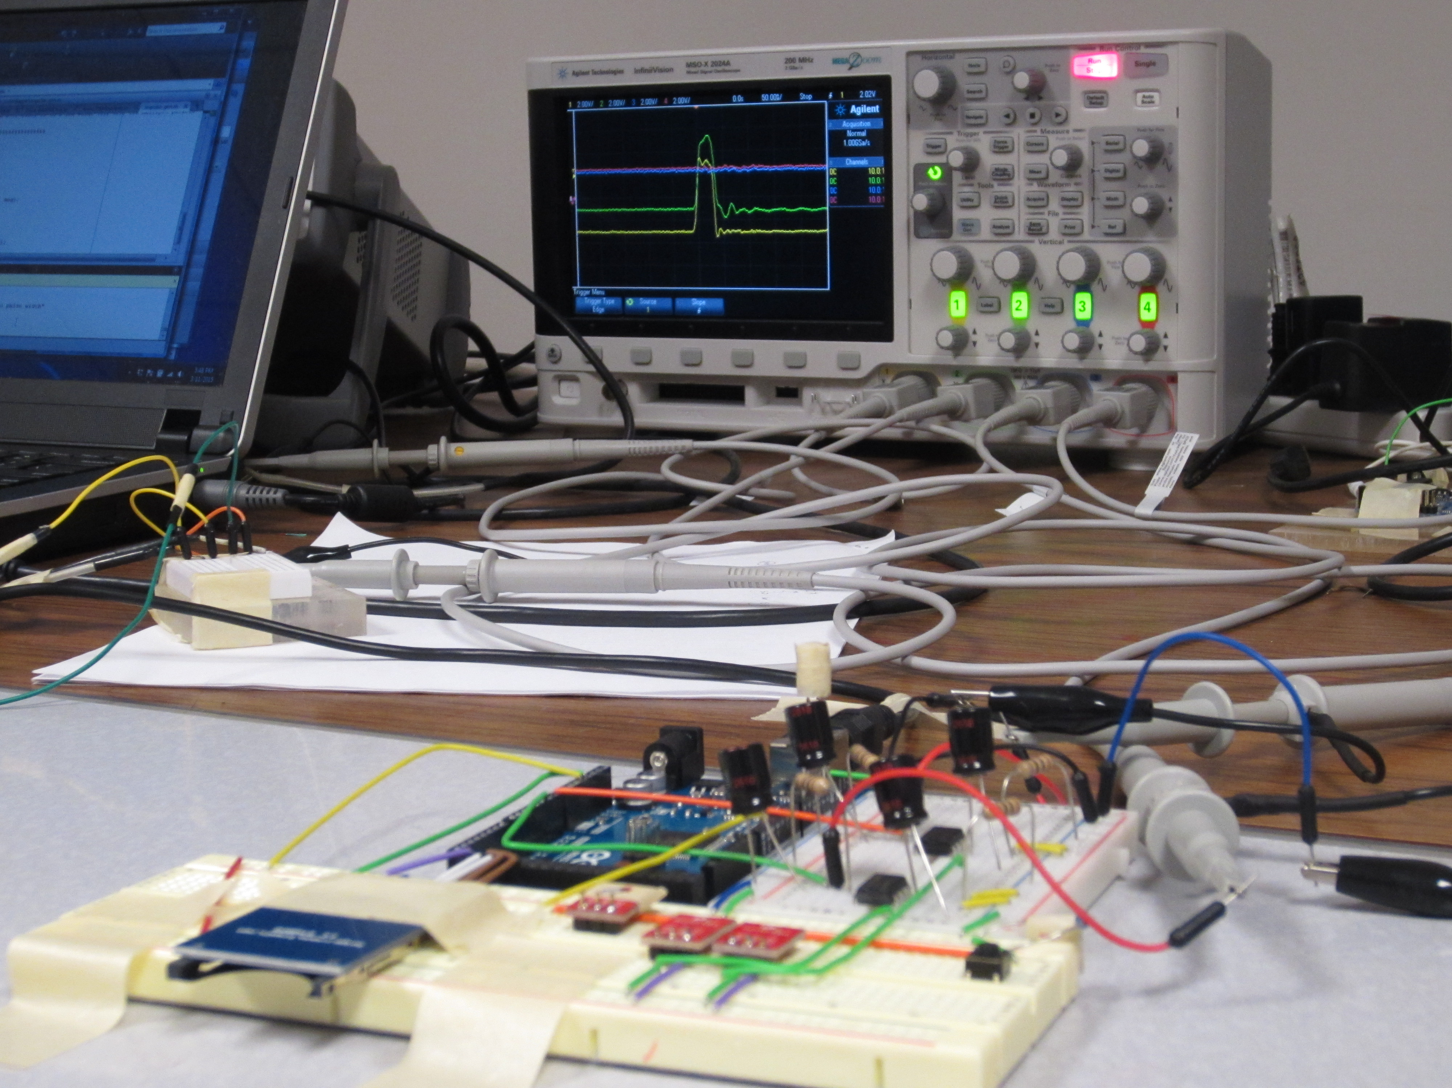
Thank You (Show Videos)
Notes:
Thank you.

